Slide 1

INSTITUTE - UIE
DEPARTMENT- ACADEMIC UNITS
Bachelor of Engineering (Computer Science & Engineering)
Subject Name: Elementary Data Structure Using C++
Code:23CSH-103
2-D Array
DISCOVER . LEARN . EMPOWER

Slide 2


Elementary Data Structure Using C++
Course Objectives
To enable the students to understand various stages and constructs of C++ programming language.
To improve their ability to analyze and address variety of problems in C++.
To understand the concept of data structures and various operations on them.
To understand the properties of various data structures and able to identify the strengths and weaknesses of different data structures.
To analyze and compare the efficiency of algorithms and learn to design efficient algorithms for solving computing problems

Slide 3



Course Outcomes
CO Number | Course Outcome
CO1 | Understand the concepts of object-oriented programming including programming process and compilation process.
CO2 | Apply different techniques to decompose a problem and programmed a solution with various concepts of object-oriented programming language.
CO3 | Analyse and explain the behaviour of linear data structure operations using the programming addressed in the course.
CO4 | Implement and evaluate the programs using the syntax and semantics of object-oriented programming.
CO5 | Design the solution of real-world problems in order to determine that the program performs as expected.

Slide 4

Scheme of Evaluation

Slide 5

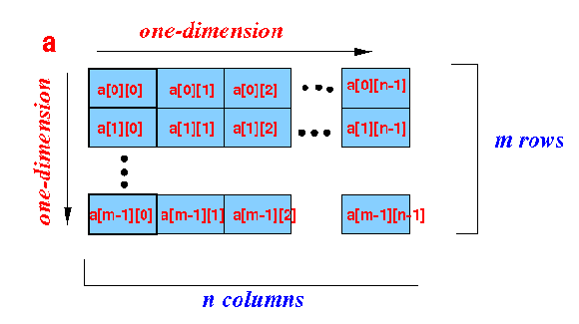
2-Dimensional Array
A two-dimensional array is an array where its elements are selected (identified) using two indices. In 2-D array, to declare and access elements of a 2-D array we use 2 subscripts instead of 1.
Syntax: data_type array_name[ROW][COL];
The total number of elements in a 2-D array is ROW*COL.
Example: int a[m][n];
In rectangular 2-dimensional arrays, m number of rows and n number of columns in the array has the same number of array elements.
A conceptual representation of 2D array

Slide 6
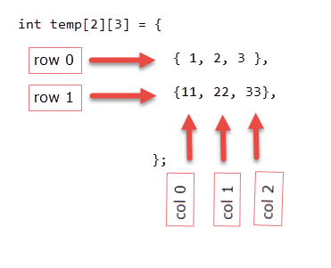
Initialization of two-dimensional array: Initialization of 2-D array is similar to a 1-D array.
Example:
Initialization 2-D Array
After this initialization, each element is as follows:
temp[0][0] : 1
temp[0][1] : 2
temp[0][2] : 3
temp[1][0] : 11
temp[1][1] : 22
temp[1][2] : 33

Slide 7
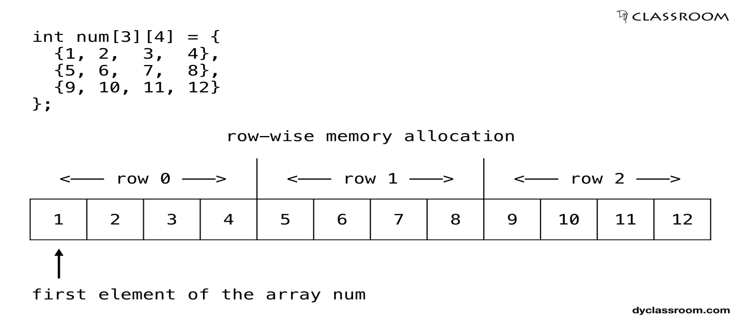
Memory Representation 2-D Array
The compiler will allocate the memory for two dimensional array row-wise meaning the first element of the second row will be placed after the last element of the first row.

Slide 8
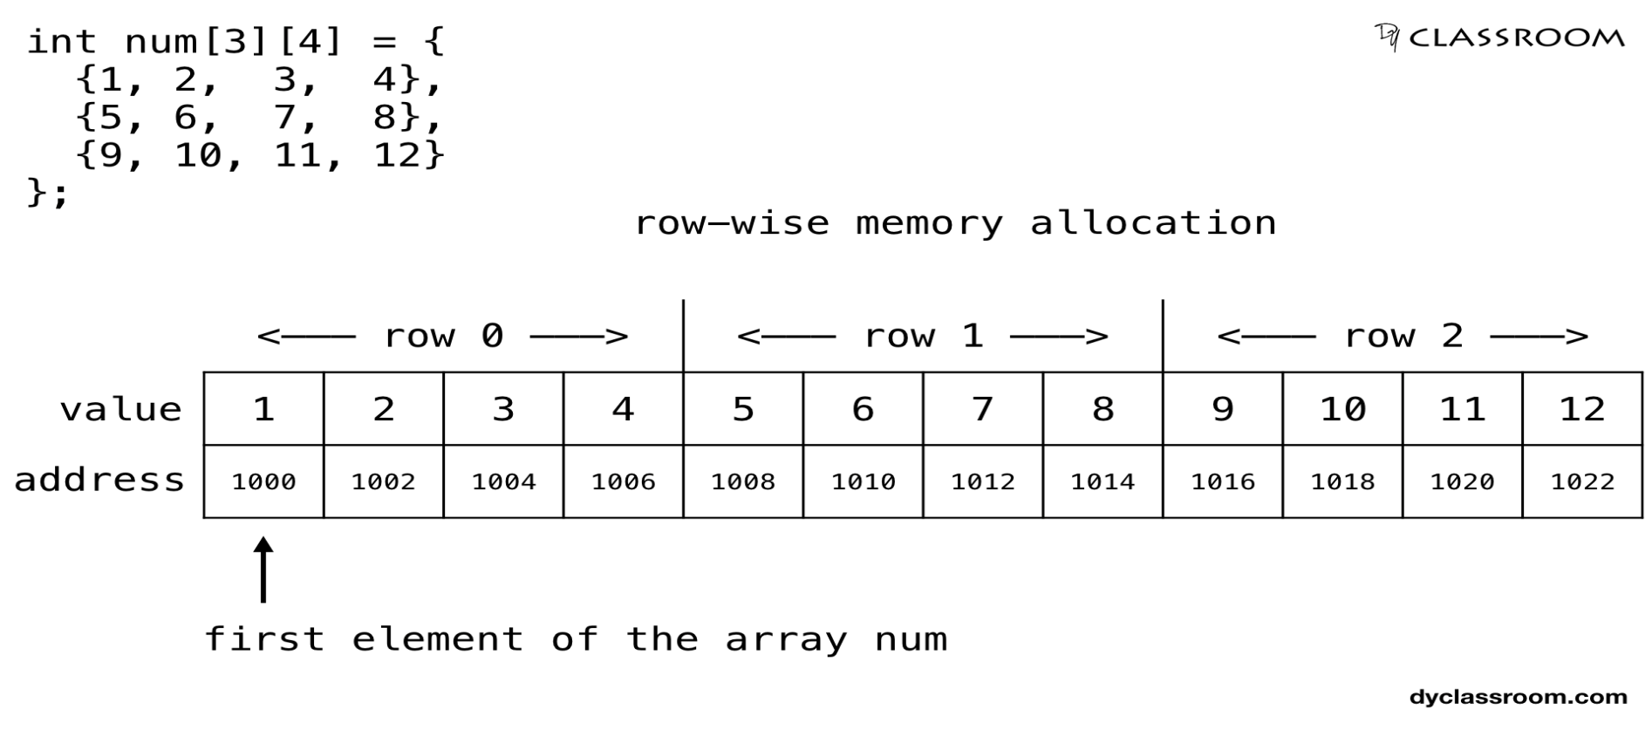
Memory Representation 2-D Array
And if we assume that the first element of the array is at address 1000 and the size of type int is 2 bytes then the elements of the array will get the following allocated memory locations.

Slide 9
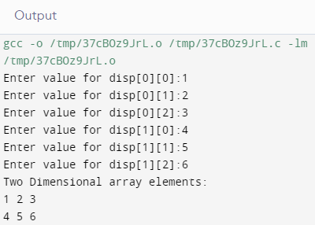
1. Program to store the elements from the user and store them in an 2D array.
#include<stdio.h>
int main()
{
int disp[2][3], i, j;
for(i=0; i<2; i++)
{
for(j=0;j<3;j++)
{
printf("Enter value for disp[%d][%d]:", i, j);
scanf("%d", &disp[i][j]);
}
}
printf("Two Dimensional array elements:\n");
for(i=0; i<2; i++)
{
for(j=0;j<3;j++)
{
printf("%d ", disp[i][j]);
if(j==2){ printf("\n");
}
}
}
return 0;
}
Examples of 2-D Array

Slide 10
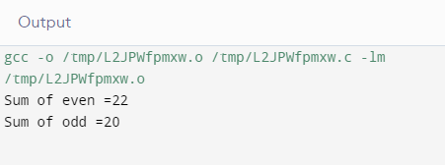
2.. Program to sum of even and odd of 2D array.
#include<stdio.h>
int main()
{
int i=0,j=0;
int arr[3][4]={{1,2,3,4},{2,3,4,5},{3,4,5,6}};
int even=0;int odd=0;
for(i=0;i<3;i++)
{
for(j=0;j<4;j++)
{
if(arr[i][j]%2==0)
{
even=even+arr[i][j];
}
else
{
odd=odd+arr[i][j];
}
}
}
printf("Sum of even =%d \n",even);
printf("Sum of odd =%d",odd);
return 0; }
Examples of
2-D Array

Slide 11
THANK YOU

